Slide 1

DataSet
Visual Question Answering
(VQA)
Supervisor Name:
郑锋
List of team members:
张一弛 11813226
杨英特 11812518

Slide 2
Introduction About our Group project
/ 01

Slide 3
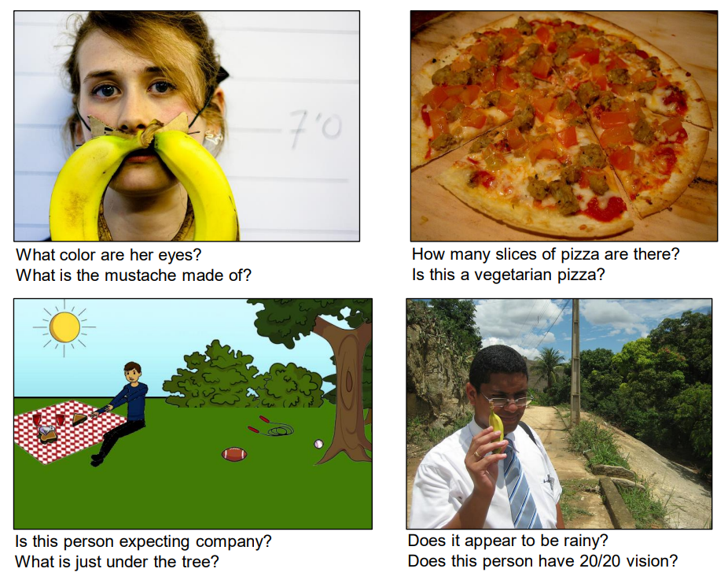
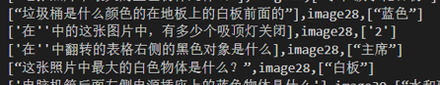
About CHS-VQA
Introduction
What is CHS-VQA
Why we do it

Slide 4
/ 02
Progress Have done and going to do

Slide 5
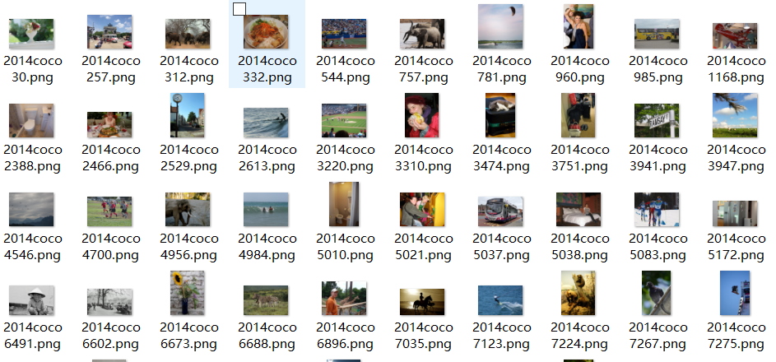
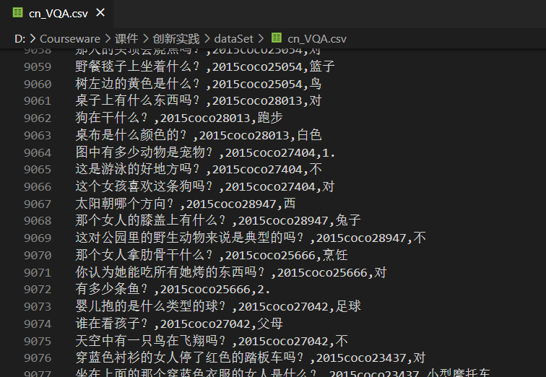
Our Progress
What we have done
Data sets
Design data sets
Images
QA-pair

Slide 6
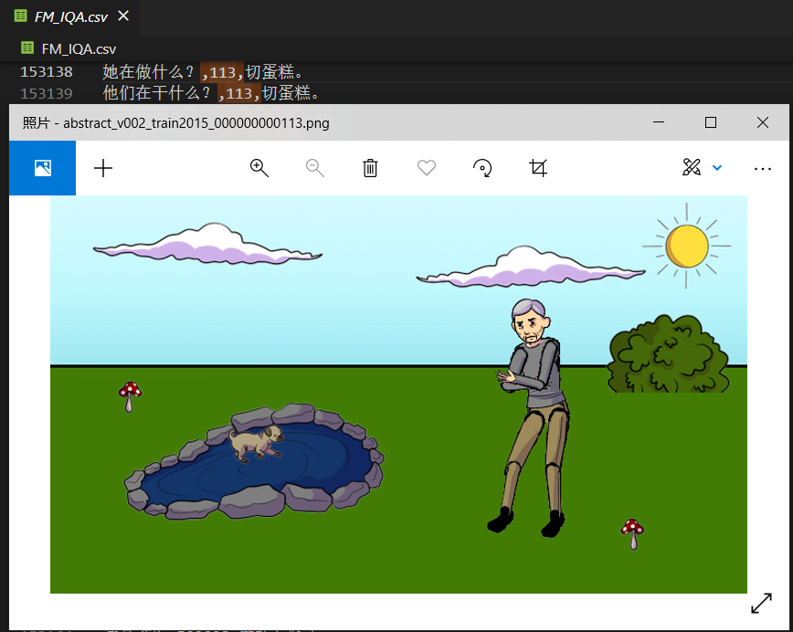
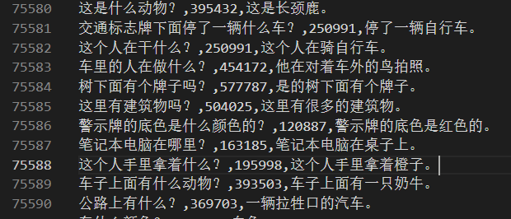
Our Progress –Date sets

Slide 7
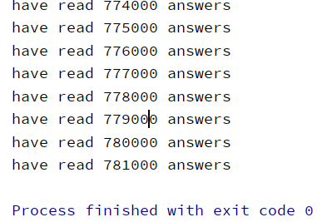
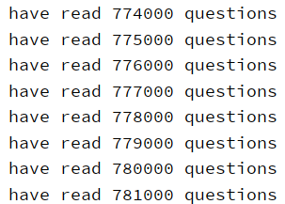
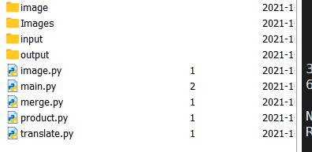
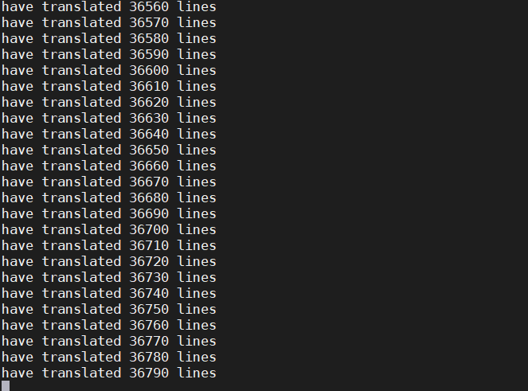
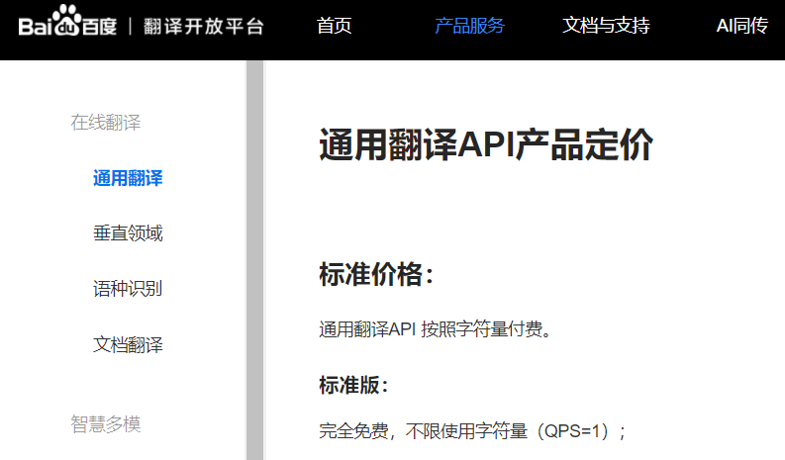
Our Progress – Design Date sets

Slide 8
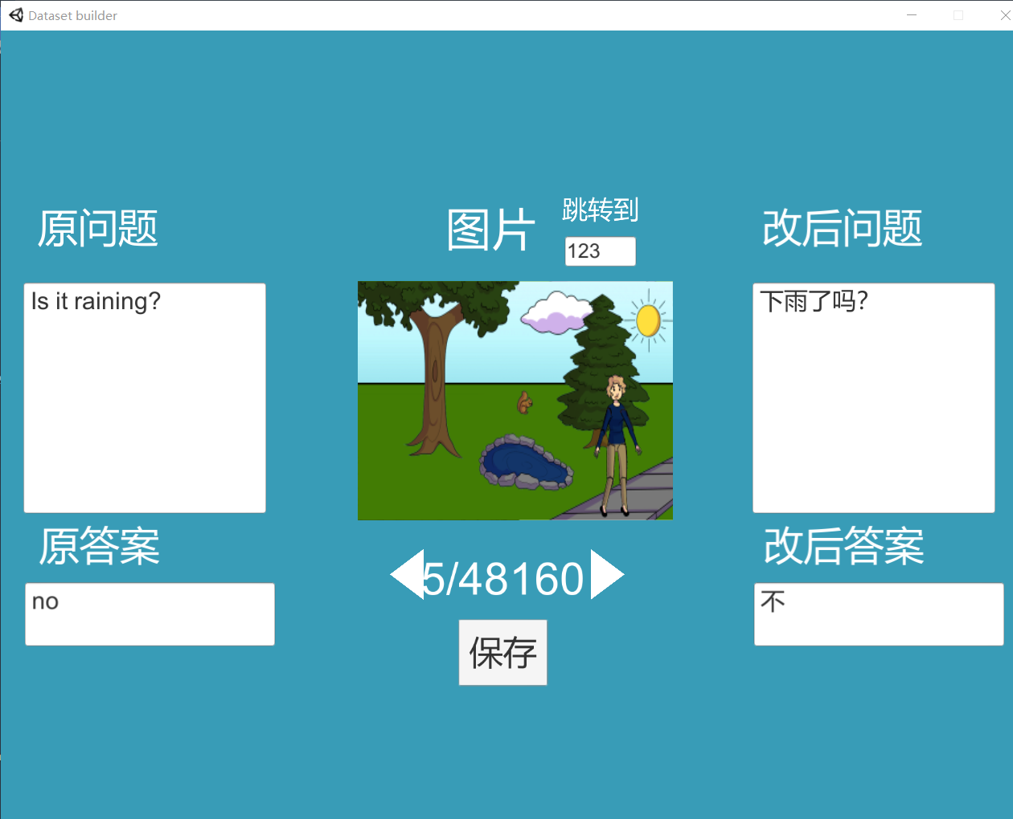
Our Progress – Design Date sets

Slide 9
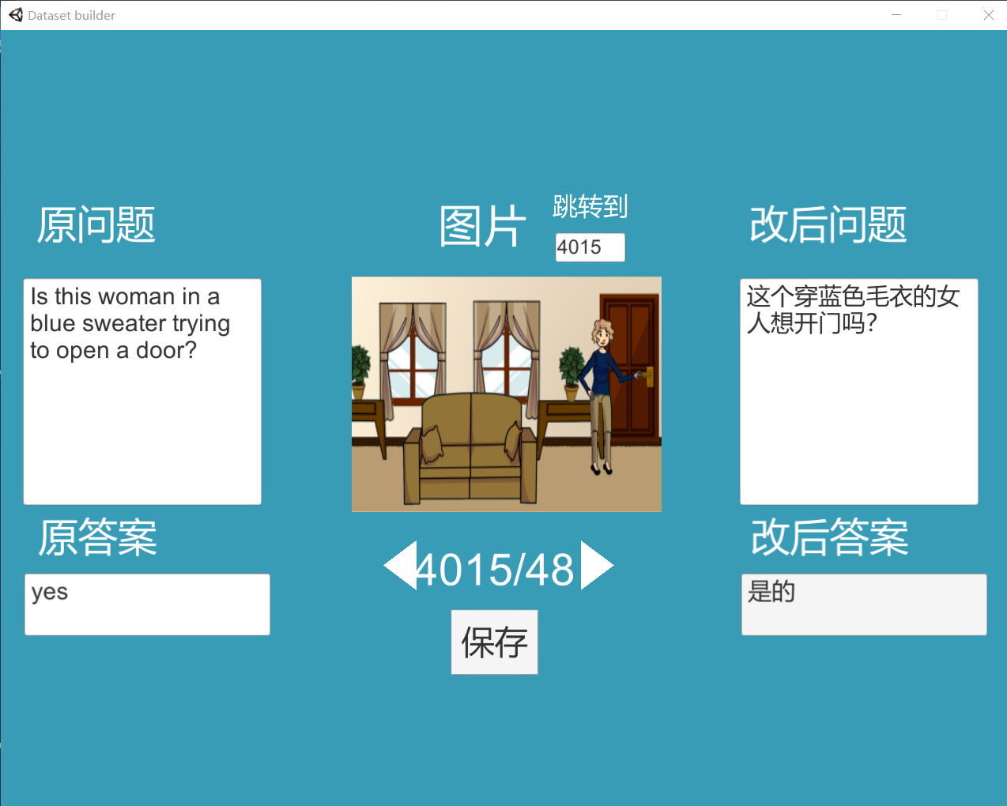
Our Progress – Design Date sets

Slide 10
Reference
[1] Zhou, B. , Tian, Y. , Sukhbaatar, S. , Szlam, A. , & Fergus, R. . VQA: Visual Question Answering.
[2] H. Gao, J. Mao, J. Zhou, Z. Huang, L. Wang, and W. Xu, \Are you talking to a machine? Dataset and methods for multilingual image question answering," in Advances in Neural Information Processing Systems (NIPS), 2015.

Slide 11
Thanks
Supervisor Name:
郑锋
List of team members:
张一弛 11813226
杨英特 11812518

